Slide 1
Move in, Move Out, Customer Transfers, and Owner Allocation Workshop A-3: Manage Customer Transfers + Manage Landlord/Tenant Mohanta Das, Jose Diaz 6/4/26

Slide 2





Overarching Design Principles
The goal of this project is to utilize standard Service Cloud V2 capabilities with minimal customizations. We will strive to modify our processes to Fit-to-Standard SAP technology as much as possible.
SAP First
We will adopt an “SAP first” strategy with all financial and operational data housed within SAP.
Fit to Standard
Rationalize Applications
We will change and adapt our existing business processes to fit to standard ‘out of the box’ functionality.
We will standardize and rationalize our applications to control costs and reduce the complexity of our IT estate.
Minimize customizations
‘Best of Breed’ by exception
Non-SAP applications will only be considered if they are considered ‘best of breed’ and are necessary to enable competitive advantage or meet complex regulatory requirements.
We will minimize customizations and keep the core clean to ease future upgrades, improving agility and scalability.

Slide 3
Workshop Agenda
TOPIC
01
Purpose
(L3) Manage Landlord/Tenant
BREAK – 10 Mins
(L3) Manage Customer Transfers
A-2 Workshop Follow Ups: Move In Hardstop, Change Contract Management, reversals, owner, & Custom Fields associated with Premise
Current and Future State Assumptions
FRICE-W
Drafted User Stories
Decisions, Action Items, Change Impacts, Wrap-Up, and Next Steps
02
03
04
05
06
07
08

Slide 4
01 Scope, Purpose, Objective

Slide 5
Scope, Purpose, Objectives
Scope
Purpose
Objective
Scope of this document covers the to-be state of Customer Transfers, and Landlord/Tenant for SAP Service Cloud v2 and SAP S4HANAer
Describe and confirm the process for Customer Transfers, and Landlord/Tenant
Offer a holistic view of all the key elements of the to-be process including organization/roles, configuration or customization if needed, data, reporting, security, and controls requirements.
Define the target-state ownership and L3 processes.
Document key assumptions/decisions and outline any FRICE-W's and reports.

Slide 6
Ownership
Workshop/PDD | Level 1 | Level 2 | Level 3 | Teams Impacted | Business Process Owner | Reviewer
18.0 A-1 Process Customer Move-In, Move-Out, Transfers, and Manage Owner Allocation | Manage Customer Service | Process Customer Move-In, Move-Out, Transfers, and Manage Owner Allocation | 18.1 Manage Customer Move in | Customer, WAM | Tarah Wilson, Dawn Pettengill | Customer Core Team
 |  |  | 18.2 Manage Customer Move out | Customer, WAM | Tarah Wilson, Dawn Pettengill | Customer Core Team
 |  |  | 18.3 Manage Customer Transfer | Customer, Finance | Tarah Wilson, Dawn Pettengill | Customer Core Team
 |  |  | 18.4 Manage Landlord/Tenant | Customer | Tarah Wilson, Dawn Pettengill | Customer Core Team
WORKSHOP FACILITATION
Facilitator: Mohanta Das, Jose Diaz
IBM Scribe: Taylor Ilov
Change Impacts: Julie Vandblarcum
CE PARTICIPANTS
Global Process Owner: Tarah Wilson, Dawn Pettengill
SMEs

Slide 7
02 (L3) Manage Landlord/Tenant

Slide 8
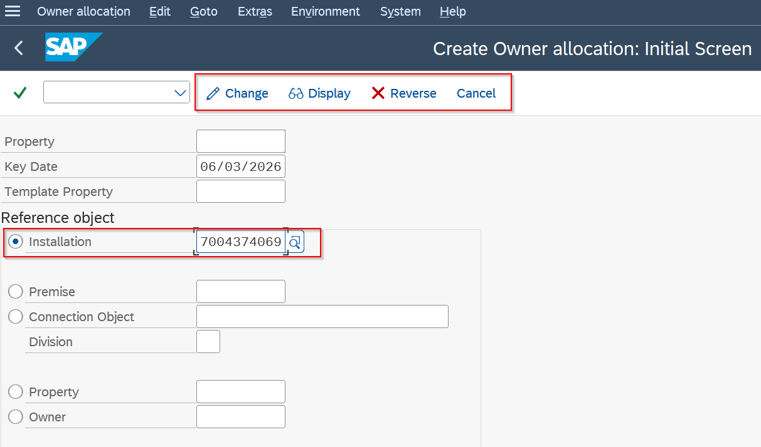
Process Overview- S4HANA Owner Allocation

Slide 9
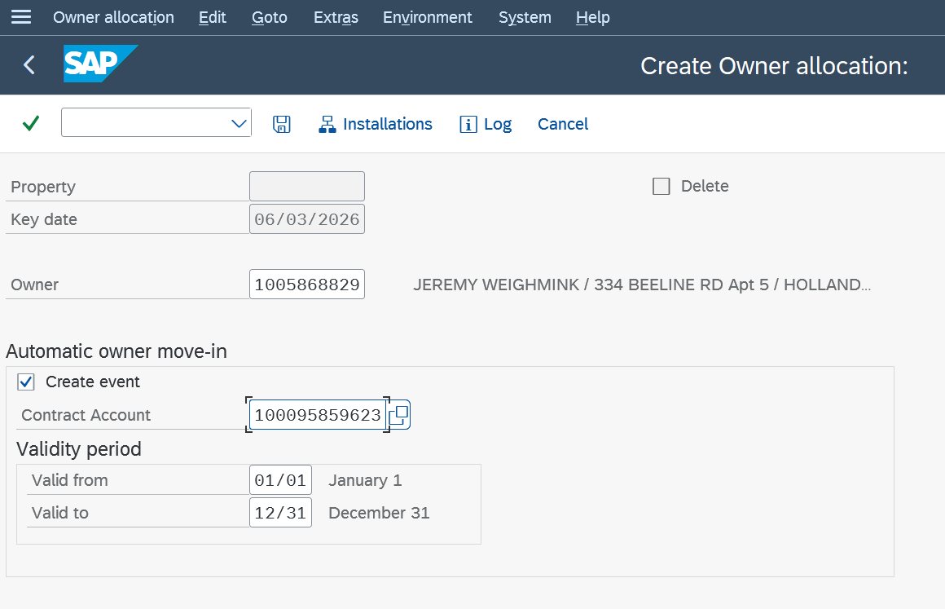
Process Overview- Enter Owner and Contract account

Slide 10
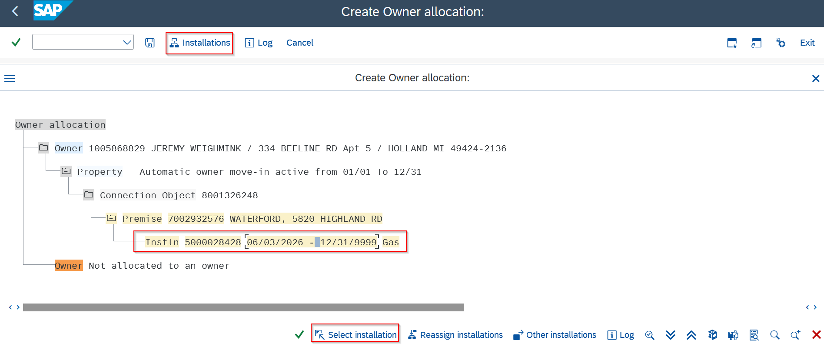
Process Overview- Select Installation and Save

Slide 11
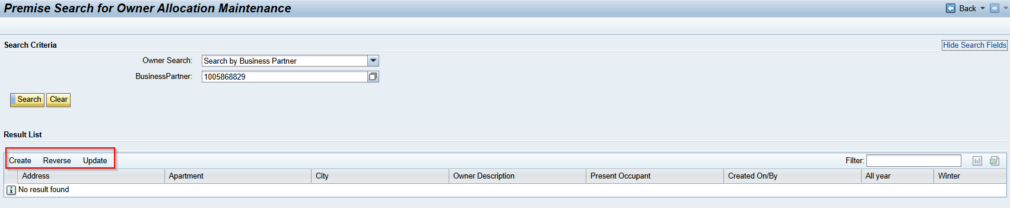
Process Overview- CRM Owner Allocation

Slide 12
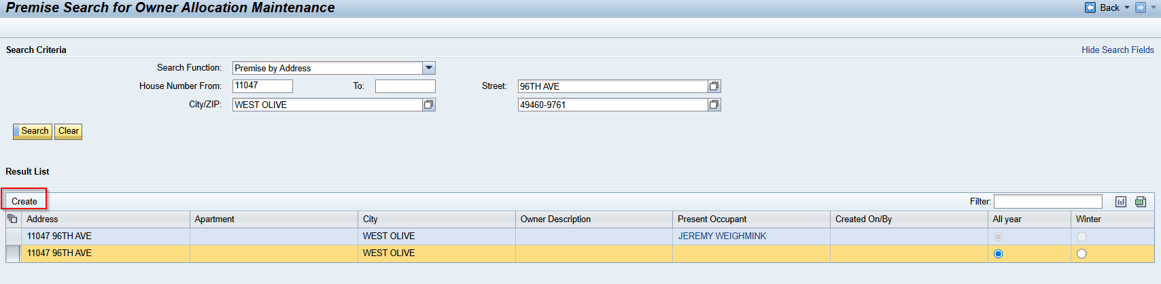
Process Overview- CRM Owner Allocation

Slide 13
Owner Allocation Workflow
Need to add for next workshop:
- Move In override for past due balances/ Hard Stop – let CSRs override move in?
- Carve out time in next workshop for Demand Enrollments
Cover MDT – Create on MDT that is existing today
add ASP identifier to search option for BP
+ RIDA 683615
Objects created on back of Move in | Criteria
Create Current Occupant if no owner allocation | Owner Allocation does not exist and service is on: If Current Occupant Move in required.
Create Contract Account for Current Occupant (Owner) | Current Occupant should move in automatically if no owner allocation and service is on.
Create Owner Move in | If OA exists on premise

Slide 14
BREAK! - 10 mins

Slide 15
03 (L3) Manage Customer Transfers

Slide 16
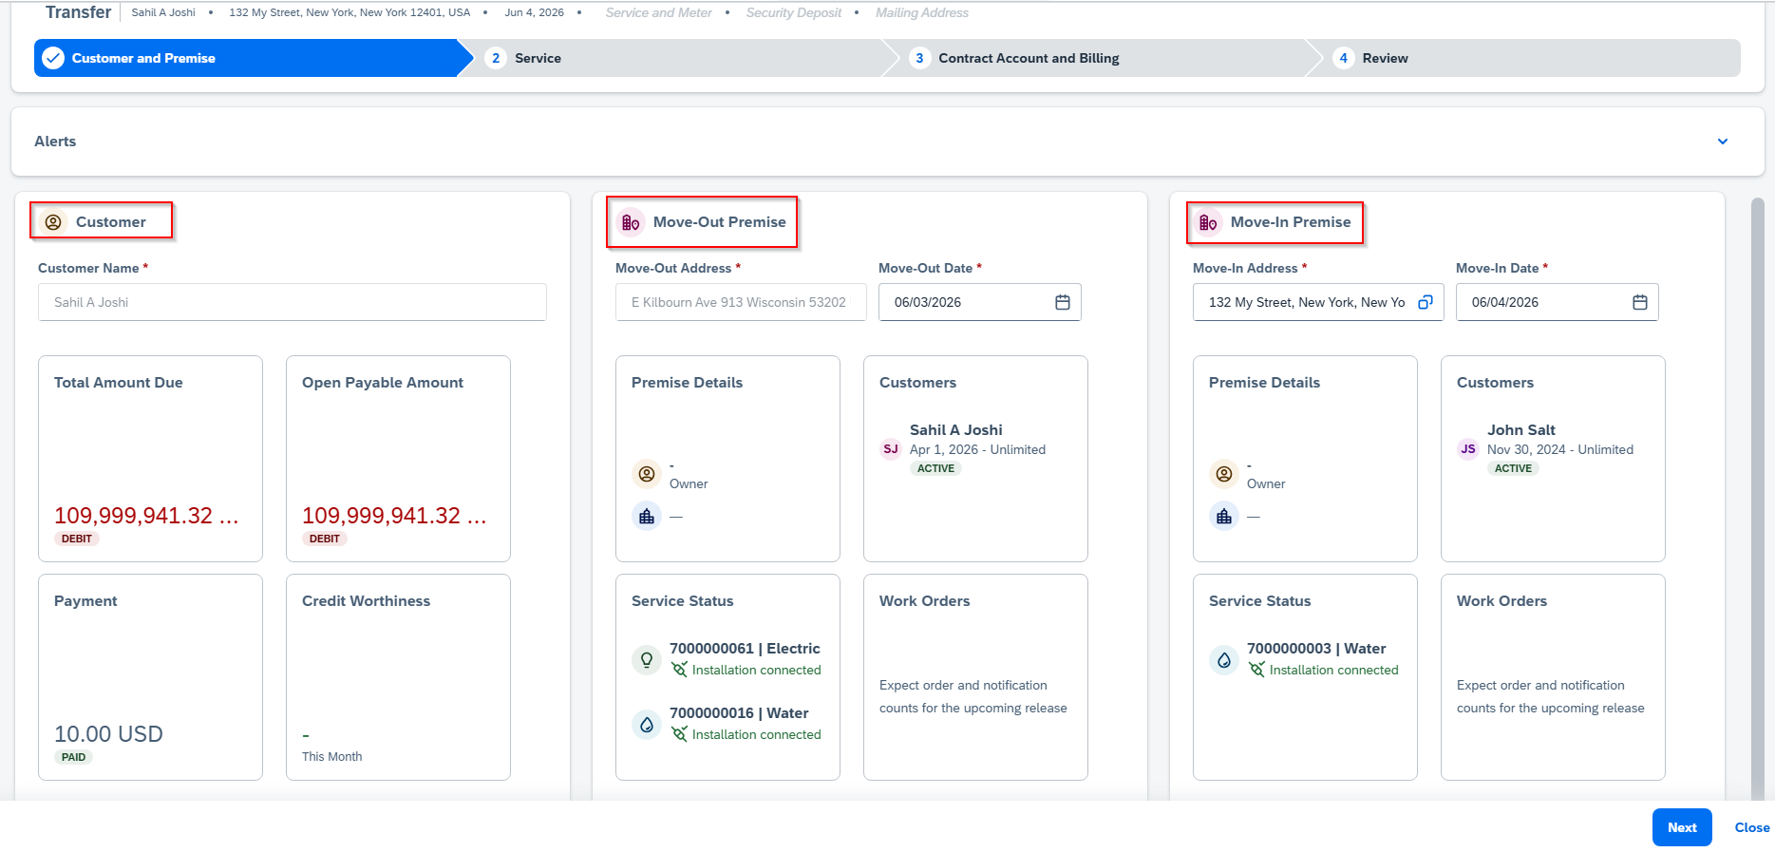
SAP Service Cloud Version2- Transfer

Slide 17
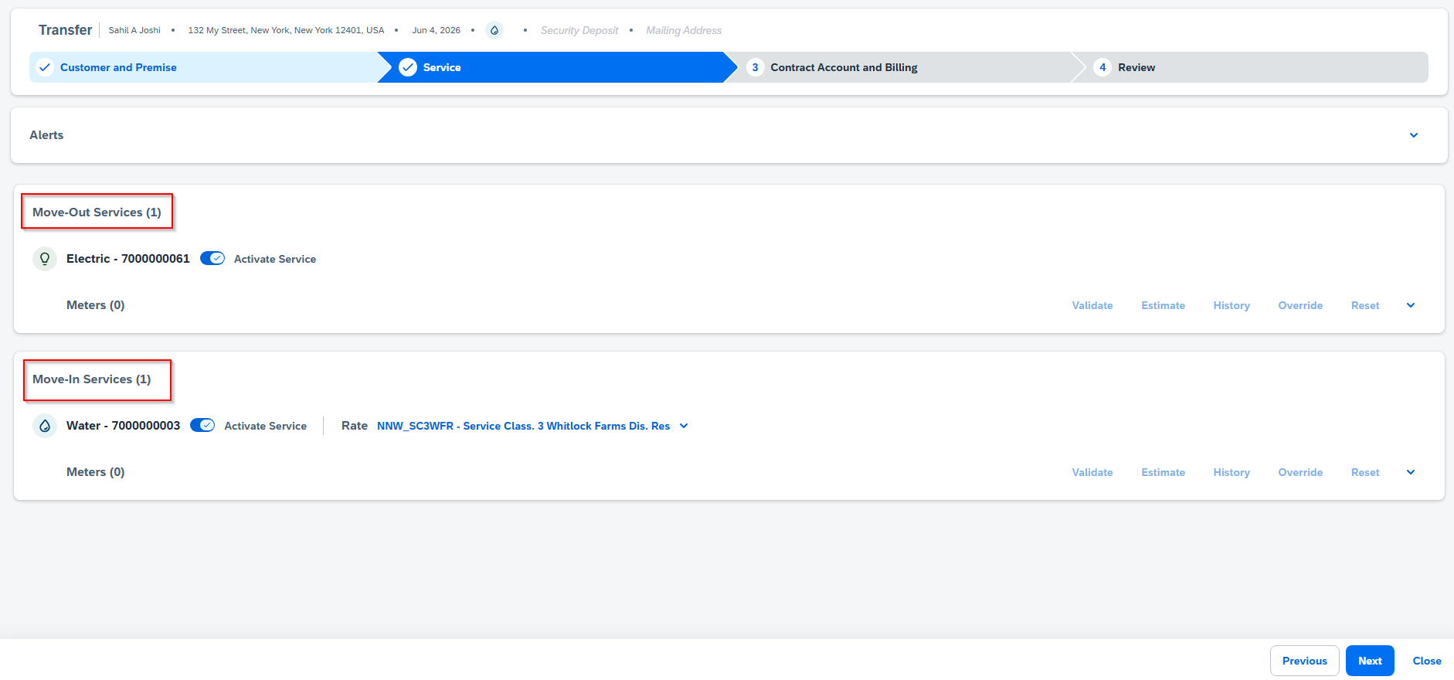
SAP Service Cloud Version2- Transfer

Slide 18
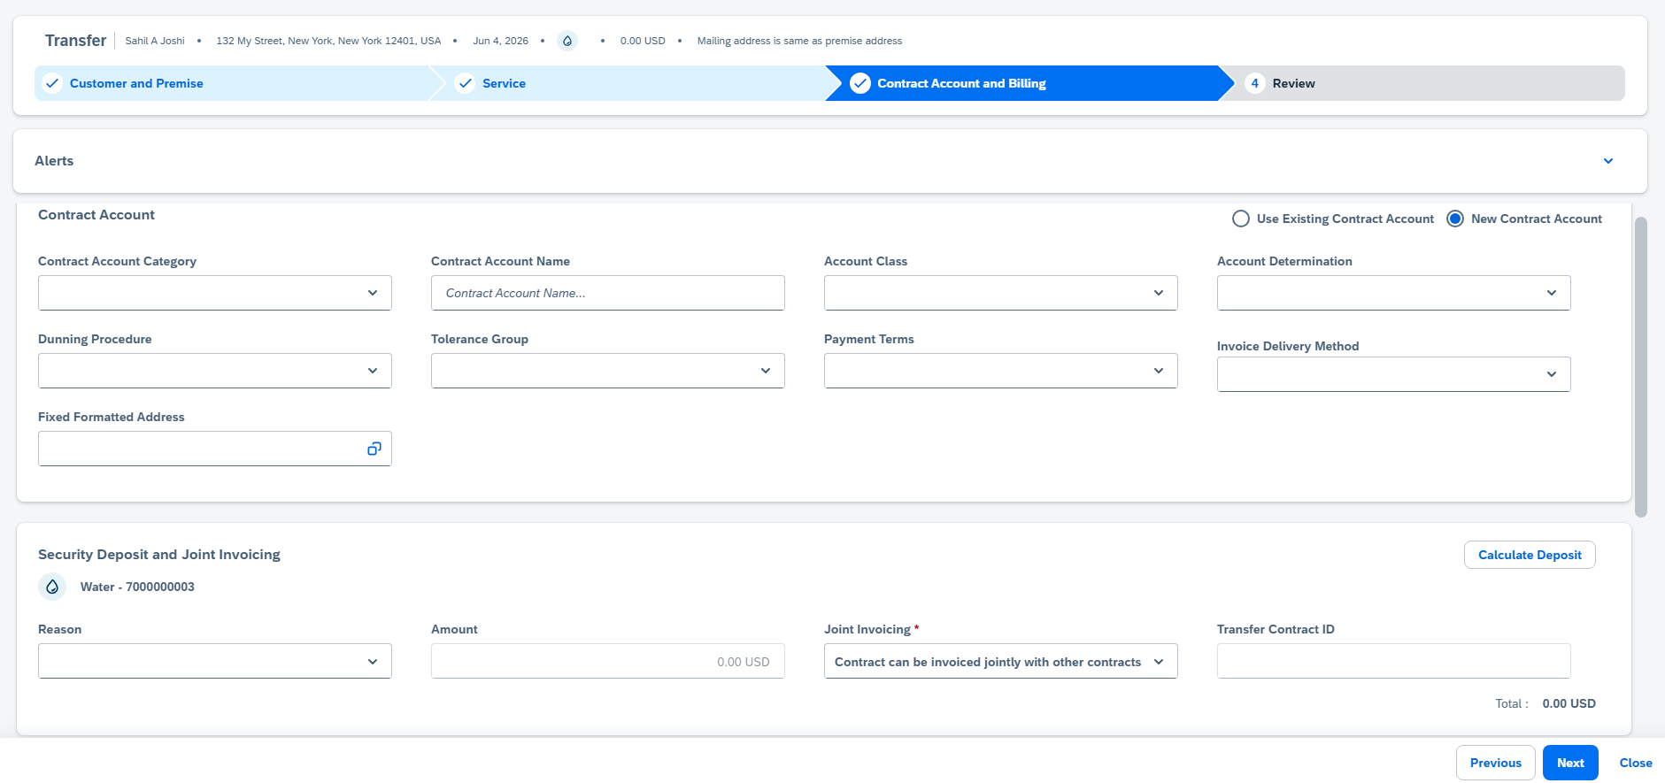
SAP Service Cloud Version2- Transfer

Slide 19
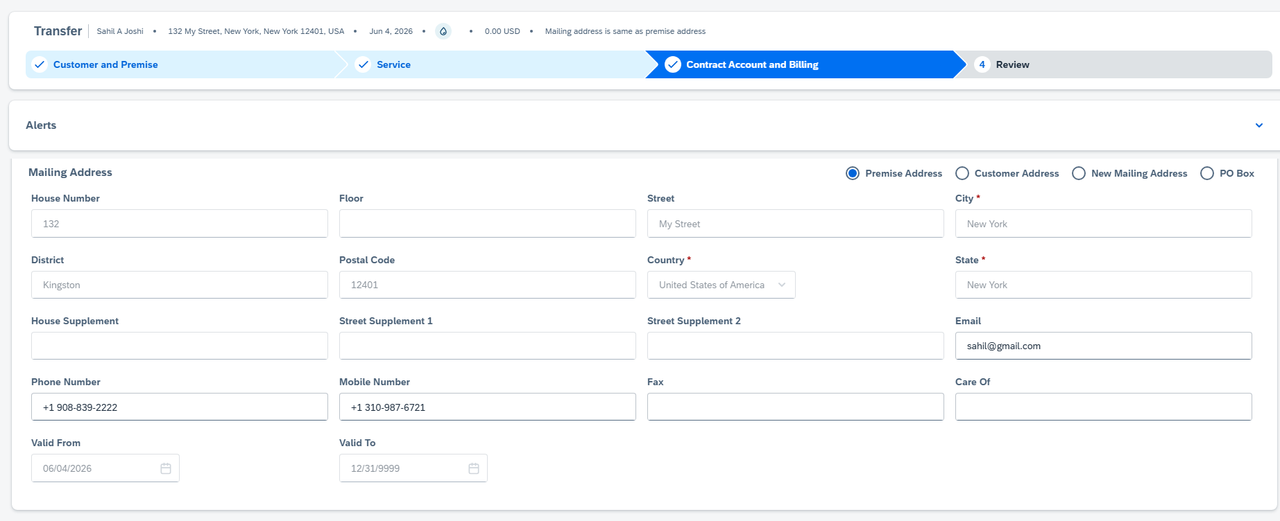
SAP Service Cloud Version2- Transfer

Slide 20
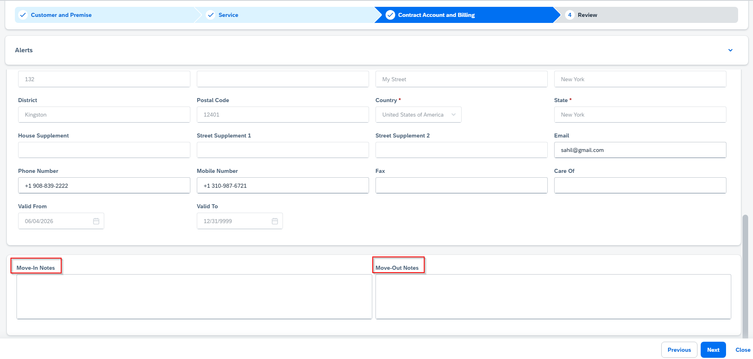
SAP Service Cloud Version2- Transfer

Slide 21
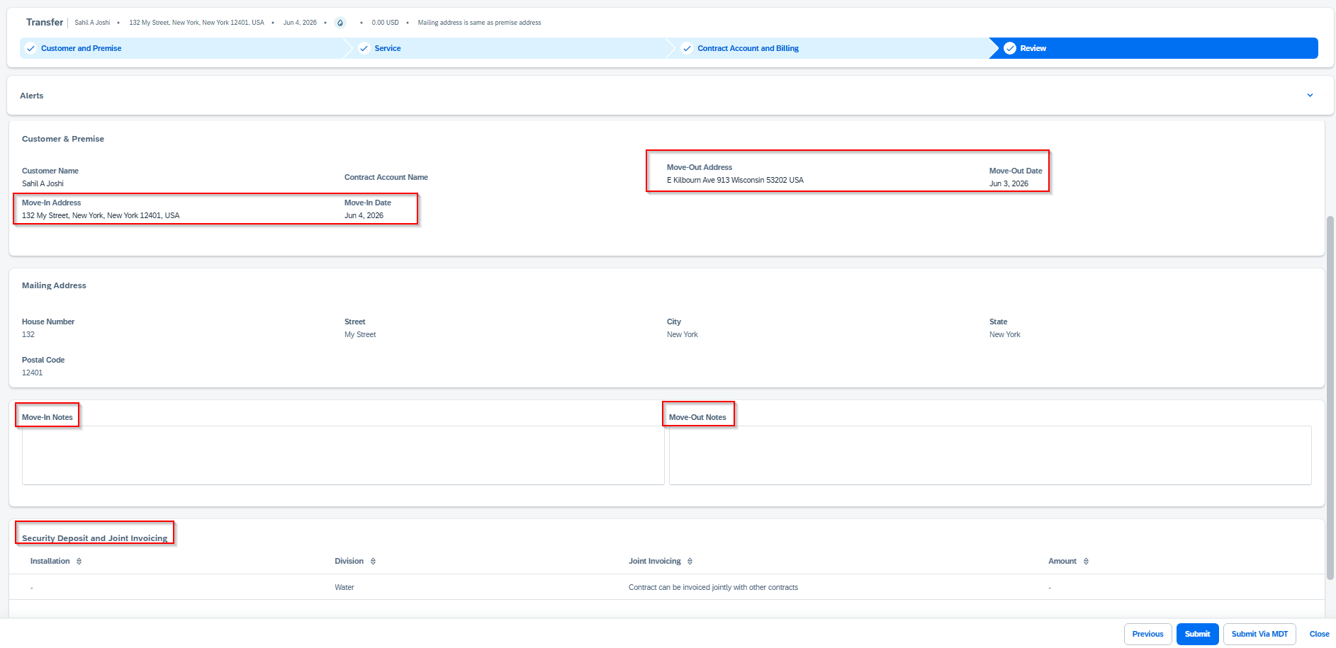
SAP Service Cloud Version2- Transfer

Slide 22
Transfer (Move In and Move Out) Workflow
Need to add for next workshop:
- Move In override for past due balances/ Hard Stop – let CSRs override move in?
- Carve out time in next workshop for Demand Enrollments
Cover MDT – Create on MDT that is existing today
add ASP identifier to search option for BP
+ RIDA 683615
Objects created on back of Move in | Criteria
Security Deposit | Dunning Level, Write off balance, Unpaid final amount due
Turn on Service order | If Device is Off.
Contact Log 1.SDR Contact Log 2.POS ID Contact Log | SDR Contact Log: Security deposit initiation. POS ID Contact Log: 1.Positive FACTA Validation- Fails 2. Non-FACTA Positive Identification (POS ID COS) triggers. Note: SDR Contact Log gets priority over POS ID Contact Log.
Connection Fees | No.
Update Device Location Notes | If BP has Threat/Theft/Fraud Identification.
Update Contract Account with Dunning lock, 2. Outgoing payment type. | If Dunning scenario. Change Contract account out going payment type to Out Going Check(C)
Send SAP Document to position 70010050 70010051 | If BP has any ASP Contract (SD Contract), contracts gets cancelled. If Premise has CAP Loan. [ Customer Attachment Program ]
Create Disconnection document
Create Current Occupant if no owner allocation | Owner Allocation does not exist and service is on: If Current Occupant Move in required.
Create Contract Account for Current Occupant (Owner) | Current Occupant should move in automatically if no owner allocation and service is on.
Create Owner Move in | If OA exists on premise

Slide 23
CE Business Requirement on Service Cloud V2:
Appointment for Move in and Move out.
2. Balance Transfer.
3. Transfer Alert.
4. Service Notification- Needs to be discussed in detail. Service Notification is not available in Service Cloud V2.

Slide 24
04 Workshop A-2 Follow Up Items

Slide 25
Follow-Up Items from A-2, needed to discuss
Hardstops (there is one for CSRs moving in Business Center accounts and then Business Center has a hardstop for accounts with certain installation flags. )
Custom Fields associated with Premise
Service Notifications
Next Week:
Change Contract Management, reversals, owner allocation
Enrollments in Demand Response (for Orders Outside of Move In Move Out Process)

Slide 26
05 Current and Future State Assumptions

Slide 27
Assumption:
Objects and Technique
No Change in Workflow.
2. No Change in MDT.
3. Manual Owner allocation needs to be executed from S4HANA Fiori. Mashup needs to be created at Premise view.
4. Transfer is collection of Move in and Move out. All the requirement captured as part of Move in and Move out workshop, should be developed in Transfer process. (Repurpose the same development for MIMO for Transfers too

Slide 28
06 FRICE-W

Slide 29
FRICE-W Identified
1. Move in field enhancements
2. Move out field enhancements
2. Enhancements in ECC may be required if looking for specific details in container from CRM7 now coming from v2 system.
3. Workflow changes in ECC may be required if looking for specific details in container from CRM7 now coming from v2 system.
4. Service Cloud enhancements to send custom container payloads for fields for certain scenarios.
5. DQM address cleanse
6. Create Contract Account Based on Current MDT Maintenance
7. Auto Populate Contract Account values
8. Create Service Orders
9. Premise enhancements
10. Enrollments
11. Security Deposits
12. Equifax check
13. Move in validations from ECC (i.e. Override past due balances)
14. Move in change event(s) placeholder
15. Move in cancel event(s) placeholder
16. Move out change event(s) placeholder
17. Move out cancel event(s) placeholder
18. Transfer items to new CA, new premise
19. change Rate, Operand
21. Smart Meter (Gas and Electric) Opt In/ Opt Out
22. Move Out Summary Script

Slide 30
07 Drafted User Stories

Slide 31
Drafted User Stories
L1 | L2 | L3 | L4 | User Story | Acceptance Criteria
Manage Customer Service | Process Customer Move-In, Move-Out, Transfers, And Manage Owner Allocation | Process Customer Transfer | Create Transfer | As a Customer Service Representative in SAP, I want to process customer Transfer from current premise to a new Premise | 1. Able to enter move-in and move-out details required to create a new record. 3.Able to validate that mandatory fields are completed before saving. 4.Able to save the new move-in and move-out record successfully. 5.Able to edit move-in and move-out information prior to final submission. 6.Able to submit the move-in and move-out creation and receive a confirmation. 7.Able to view the created move-in and move out record after submission. 8.Able to view error messages when move-in and move-out creation fails. 9.Able to build Security roles and perform testing. 10.Able to identify Risk and Controls
Manage Customer Service | Process Customer Move-In, Move-Out, Transfers, And Manage Owner Allocation | Process Owner Allocation | Create Owner Allocation on back of move out / Transfer. | As a Customer Service Representative, I want to process customer Move out/ Transfer, owner should be allocated automatically via workflow. | If owner already exists, Create owner move in. If Owner does not exist, create Occupant, Occupant Contract Account and move in.
Manage Customer Service | Process Customer Move-In, Move-Out, Transfers, And Manage Owner Allocation | Process Owner Allocation | Create Manual Owner Allocation | As a Customer Service Representative / Back- office Team , I want to manually assign Owner into a Premise via S4HANA Fiori. | Able to enter Occupant, Contract Account

Slide 32
08 Decisions, Action Items, Change Impacts, Wrap-Up & Next Steps

Slide 33
Program Charging (CE Internal Only)
The Change & Why:
We need to track O&M costs more precisely. OCM and Data Conversion must be charged separately from End User Training and from Design/Build/Deployment work. This change is retroactive from February for Accounting, Rate case discovery, and audit.
Ask:
Pls follow the instructions below that apply to you based on your staffing category on the LaunchPad program. It is critical to track costs in the correct cost buckets.
Business Partner (BP) Core Team (Use SAP*):
Continue 100% allocation as before. (BP&A handles this automatically behind the scenes and no time entry is needed except for the two scenarios below)
Submit time only for OCM and Data Conversion activities; Use SAP to bill IO 6520973.
Submit time only for End User Training; Use SAP to bill IO 6519532.
IT Core Team (Use Clarity):
S4- Customer – Design/Development/Testing/Deploy Clarity Task
Clarity Timesheets will now be used for time charging, and the allocation mechanism is discontinued. Submit timesheets from February 2nd for a one-time catchup.
Separate tasks for OCM, End User Training, and Data Conversion are available; Find them using keywords OCM, End User Training, and Data Conversion and charge them as applicable.
Extended BP Team (use SAP*):
Bill SAP IO 6520973 for OCM and Data Conversion.
Bill SAP IO 6519532 for End User Training.
Use new IO 6521411 for all other tasks.
Extended IT Team (Use Clarity):
S4- Customer – Design/Development/Testing/Deploy Clarity Task
Bill specific tasks for OCM, End User Training, and Data Conversion; ID the tasks using the keywords OCM, End User Training, and Data Conversion.
Bill other tasks as appropriate.
*SAP Timesheet Submission Instructions (for BPs)
Follow ESS steps (screen shot below): 1. Open ESS timesheet. 2. Enter IO number in work order field. 3. Select WORK code under ATT-ABS. 4. Add OCM, End User Training, or Data Conversion in comments. 5. Enter hours worked.

Slide 34
Appendix

